Slide 1



Startup Company
Kfintech Pvt Ltd

Slide 2
Kfintech Company
Name
Place & Year
Mission & Vision
Struggle
Achievement

Slide 3

Introduction
KFintech is the largest RTA and a market leader in the financial sector. We specialize in Mutual Funds, Corporate Registry, NPS, and many more. The company provides SaaS based end-to-end transaction management, channel management, compliance solutions, data analytics and various other digital services
3

Slide 4
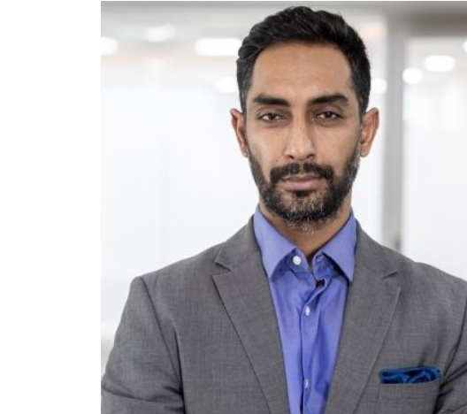
Founder & CEO | Kfintech Company
Sreekanth Nadella has been working as a Chief Executive Officer at KFintech Technologies Private for 5 years. KFintech Technologies Private is part of the Finance industry, and located in India.
Under his leadership, KFintech has serviced over 100 million key investor accounts, to reach out to 3500+ issuers including banks, PSUs, and mutual funds. Sreekanth’s extraordinary efforts have witnessed key decisions to develop aspirational services and grow fast in India and overseas. Sreekanth has also led some key acquisitions and the expansion of KFintech as a leading SaaS company.
Sreekanth Nadella
Founder & CEO |Kfintech

Slide 5
1
Name of The Startup App :
KFintech is the largest RTA and a market leader in the financial sector. We specialize in Mutual Funds, Corporate Registry, NPS, and many more. The company provides SaaS based end-to-end transaction management, channel management, compliance solutions, data analytics and various other digital services
2
Name of The Founder Owner :
Sreekanth Nadella has been working as a Chief Executive Officer at KFintech Technologies Private for 5 years. KFintech Technologies Private is part of the Finance industry, and located in India
3
Startup Starts Year :
KFintech was founded by Sreekanth Nadella in June 8, 2017. KFin Technologies, a technology-driven financial services platform providing comprehensive services and solutions to the capital markets ecosystem across asset classes, has today announced that its Chief Executive Officer (CEO), Sreekanth Nadella has been elevated to the role of Managing Director (MD) and CEO of the organization.
4
Startup Starts Place :
The Main Headquarters of Apna in Nanakramguda, Serilingampally, Hyderabad, Rangareddi, Telangana India - 500 032. KFin Technologies is majority-owned by funds managed by private equity investor General Atlantic.

Slide 6
5
Achievement of the Start up :
Servicing over 90 million investors, and over one lakh transactions daily, KFintech has managed the two largest migrations in the mutual fund space, as well as corporate registry involving over 15 million investors. The company has decided to allocate over 1.84 crore equity shares to 44 funds at Rs 366 apiece, aggregating the transaction size to Rs 675 crore, according to a circular uploaded on the BSE website on Friday.
6
Struggle of the Start up :
Alternative asset managers frequently struggle with fragmented markets, legacy technology, diverse systems, and cost pressures. KFintech's AIF services enable asset managers to untangle the complexities of administering their funds and keep them going!
7
Mission of the Start up :
KFintech serves the mission-critical needs of asset managers with clients spanning mutual funds, AIFs (alternative investments), pension, wealth managers KFintech serves the mission-critical needs of asset managers with clients spanning mutual funds, AIFs (alternative investments), pension, wealth managers

Slide 7
7
Mission of the Start up :
KFintech's vision is to be the most preferred and proactive solutions provider for investment managers and intermediaries enabling differentiated growth.
At KFintech, our vision is to be the trusted technology partner to all financial service providers. As we expand our business to newer geographies and asset
KFintech is the largest RTA and a market leader in the financial sector, specialized in Mutual Funds, Corporate Registry, NPS, and many more. KFin Technologies Private Limited is the largest registrar and transfer agency and a market leader in the financial sector providing investor servicing.

Slide 8
“Business opportunities are like buses. There’s always another one coming.”

